Slide 1
Chapter 12: File System Implementation
File System Structure
File System Implementation
Directory Implementation
Allocation Methods
Free-Space Management
Efficiency and Performance
Recovery
Log-Structured File Systems
NFS
Operating System Concepts

Slide 2
File-System Structure
File structure
  Logical storage unit
  Collection of related information
File system resides on secondary storage (disks).
File system organized into layers.
File control block – storage structure consisting of information about a file.
Operating System Concepts

Slide 3

Layered File System
Operating System Concepts

Slide 4

A Typical File Control Block
Operating System Concepts

Slide 5
In-Memory File System Structures
The following figure illustrates the necessary file system structures provided by the operating systems.
Figure 12-3(a) refers to opening a file.
Figure 12-3(b) refers to reading a file.
Operating System Concepts

Slide 6

In-Memory File System Structures
Operating System Concepts

Slide 7
Virtual File Systems
Virtual File Systems (VFS) provide an object-oriented way of implementing file systems.
VFS allows the same system call interface (the API) to be used for different types of file systems.
The API is to the VFS interface, rather than any specific type of file system.
Operating System Concepts

Slide 8
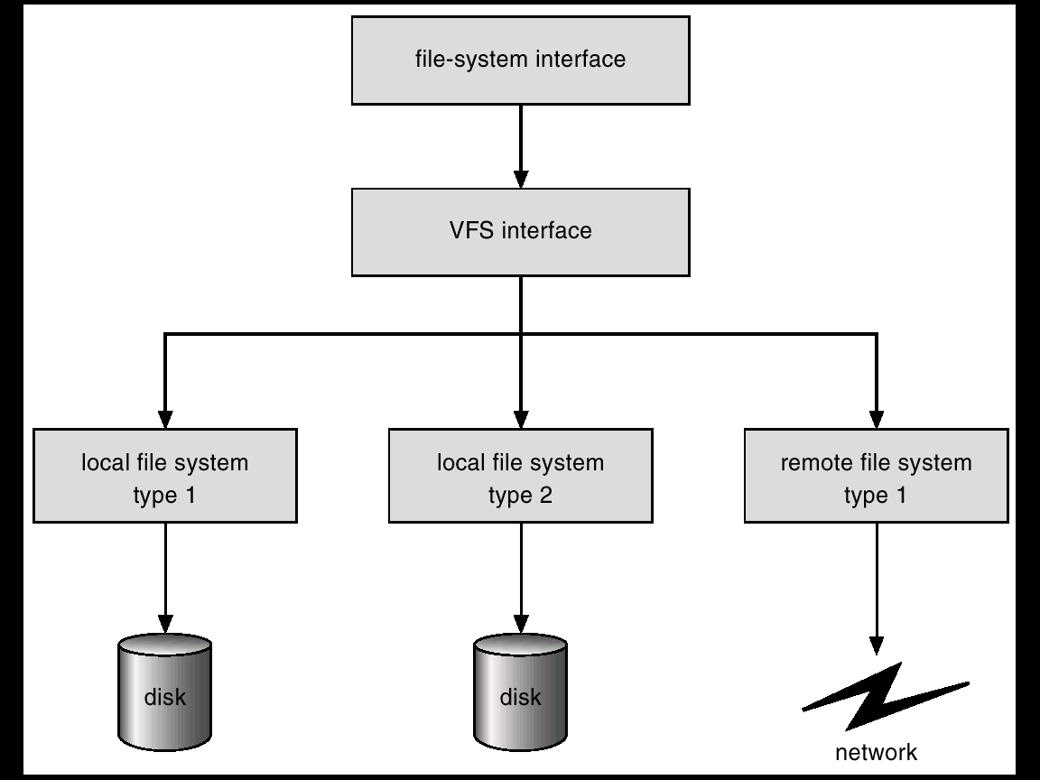
Schematic View of Virtual File System
Operating System Concepts

Slide 9
Directory Implementation
Linear list of file names with pointer to the data blocks.
  simple to program
  time-consuming to execute
Hash Table – linear list with hash data structure.
  decreases directory search time
  collisions – situations where two file names hash to the same location
  fixed size
Operating System Concepts

Slide 10
Allocation Methods
An allocation method refers to how disk blocks are allocated for files:
Contiguous allocation
Linked allocation
Indexed allocation
Operating System Concepts

Slide 11
Contiguous Allocation
Each file occupies a set of contiguous blocks on the disk.
Simple – only starting location (block #) and length (number of blocks) are required.
Random access.
Wasteful of space (dynamic storage-allocation problem).
Files cannot grow.
Operating System Concepts

Slide 12

Contiguous Allocation of Disk Space
Operating System Concepts

Slide 13
Extent-Based Systems
Many newer file systems (I.e. Veritas File System) use a modified contiguous allocation scheme.
Extent-based file systems allocate disk blocks in extents.
An extent is a contiguous block of disks. Extents are allocated for file allocation. A file consists of one or more extents.
Operating System Concepts

Slide 14
Linked Allocation
Each file is a linked list of disk blocks: blocks may be scattered anywhere on the disk.
block =
pointer
Operating System Concepts

Slide 15

Linked Allocation
Operating System Concepts

Slide 16

File-Allocation Table
Operating System Concepts

Slide 17
Indexed Allocation
Brings all pointers together into the index block.
Logical view.
index table
Operating System Concepts

Slide 18

Example of Indexed Allocation
Operating System Concepts

Slide 19
Indexed Allocation (Cont.)
Need index table
Random access
Dynamic access without external fragmentation, but have overhead of index block.
Mapping from logical to physical in a file of maximum size of 256K words and block size of 512 words. We need only 1 block for index table.
Q
LA/512
R
Q = displacement into index table
R = displacement into block
Operating System Concepts

Slide 20
Indexed Allocation – Mapping (Cont.)
Mapping from logical to physical in a file of unbounded length (block size of 512 words).
Linked scheme – Link blocks of index table (no limit on size).
Q₁
LA / (512 x 511)
R₁
  Q₁ = block of index table
  R₁ is used as follows:
Q₂
R₁ / 512
R₂
  Q₂ = displacement into block of index table
  R₂ displacement into block of file:
Operating System Concepts

Slide 21
Indexed Allocation – Mapping (Cont.)

outer-index
index table
file
Operating System Concepts

Slide 22

Combined Scheme: UNIX (4K bytes per block)
Operating System Concepts

Slide 23
Free-Space Management
Bit vector (n blocks)
0
1
2
n-1
…
0 ⇒ block[i] free
1 ⇒ block[i] occupied
bit[i] =

Block number calculation
(number of bits per word) *
(number of 0-value words) +
offset of first 1 bit
Operating System Concepts

Slide 24
Free-Space Management (Cont.)
Bit map requires extra space. Example:
block size = 2¹² bytes
disk size = 2³⁰ bytes (1 gigabyte)
n = 2³⁰/2¹² = 2¹⁸ bits (or 32K bytes)
Easy to get contiguous files
Linked list (free list)
  Cannot get contiguous space easily
  No waste of space
Grouping
Counting
Operating System Concepts

Slide 25
Free-Space Management (Cont.)
Need to protect:
  Pointer to free list
  Bit map
    Must be kept on disk
    Copy in memory and disk may differ.
    Cannot allow for block[i] to have a situation where bit[i] = 1 in memory and bit[i] = 0 on disk.
  Solution:
    Set bit[i] = 1 in disk.
    Allocate block[i]
    Set bit[i] = 1 in memory
Operating System Concepts

Slide 26

Linked Free Space List on Disk
Operating System Concepts

Slide 27
Efficiency and Performance
Efficiency dependent on:
  disk allocation and directory algorithms
  types of data kept in file’s directory entry
Performance
  disk cache – separate section of main memory for frequently used blocks
  free-behind and read-ahead – techniques to optimize sequential access
  improve PC performance by dedicating section of memory as virtual disk, or RAM disk.
Operating System Concepts

Slide 28

Various Disk-Caching Locations
Operating System Concepts

Slide 29
Page Cache
A page cache caches pages rather than disk blocks using virtual memory techniques.
Memory-mapped I/O uses a page cache.
Routine I/O through the file system uses the buffer (disk) cache.
This leads to the following figure.
Operating System Concepts

Slide 30
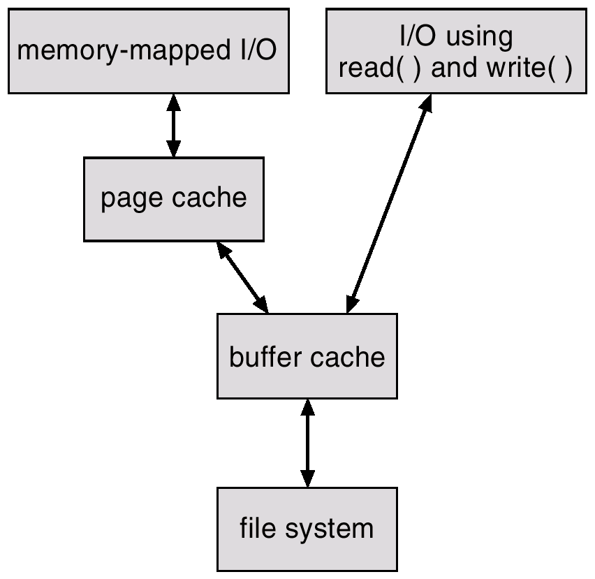
I/O Without a Unified Buffer Cache
Operating System Concepts

Slide 31
Unified Buffer Cache
A unified buffer cache uses the same page cache to cache both memory-mapped pages and ordinary file system I/O.
Operating System Concepts

Slide 32
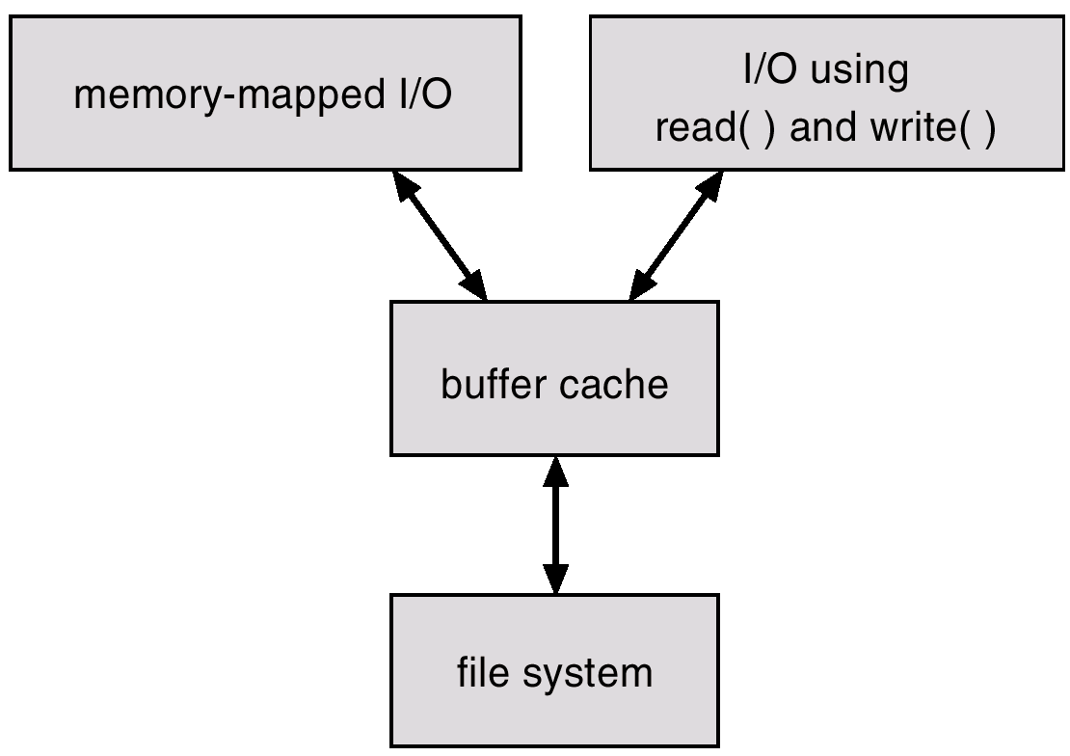
I/O Using a Unified Buffer Cache
Operating System Concepts

